Slide 1
Myocardial Infarction from ECG Signal
TEAM – 29
CS20B1126
EC20B1048
EC20B1100

Slide 2
Myocardial Infarction
Myocardial infarction (MI), also known as a cardiac attack. MI occurs when a coronary artery is so severely blocked leading to the insufficient supply of nutrients and the oxygen-rich blood to a section of heart muscle.(prolonged myocardial ischemia-inadequate blood flow toward coronary arteries).
Symptoms:
Chest pain or discomfort, shortness of breath, sweating, nausea, and pain or discomfort in the arms, back, neck, or jaw.
Factors that increase the risk of MI:
Age, Family History, High BP, High cholesterol, Smoking, Diabetes, Stress.
AIM : Detection of Myocardial Infarction from ECG Signal

Slide 3

TEAM-29
Detection of Myocardial Infarction from ECG Signal
Detection Through Combining CNN and Bi-LSTM
Detection of MI Based on Novel Deep Transfer Learning Methods for Urban Healthcare
Detection Based on Multi-lead Ensemble Neural Network
1.ECG signal is clinically used by cardiologists as a screening tool to precisely detect MI.
2.Deep learning model based on the combination of a one-dimensional convolutional neural network (1D-CNN) and bidirectional long short-term memory (Bi-LSTM) were used in this model.
3.Using this 12-lead information results in better performance and understanding, previous algorithms didn’t include 12-lead information to avoid complexity.
4.QRS Detection, P,T and J points Detection
have become more accurate in this model.
Database:12-lead ECG data from Physikalisch-Technische Bundesanstalt (PTB) dataset.
1. ECG (Most Common method),MRI,Echocardiography
2. Machine Learning models=>Algo-harmonic phase distribution pattern of the ECG data,Multiresolution properties of wavelet transform,SVM,kNN
Problem : Overfitting and performance degradation
3.Deep feature learning and soft max regression,Multi-scale discrete wavelet transform ,11-layer 1-D CNN,(MFB-CNN)
Problem : Increase in computation cost.
Deep 2-D CNN with grayscale ECG images.
VGG-Net
1.VGG-MI1 model((Fine-tuning)
2.VGG-MI2 mode( feature extractor).
Database:Physikalisch-technische bundesanstalt (PTB)
Preprocessing (1-D to 2-D(filtering))=>CNN classification Stage(controls overfitting and10-fold cross-validation strategy is)=>Training(SGD and QG-MSVM classifier)=>Data Augmentation(Robustness increase)=>Testing=>Results
Testing With 4 different cases
1.Multi-lead ensemble neural network (MENN) for the automated detection of anterior myocardial infarction (AMI) and inferior myocardial infarction (IMI) using ECG
2.MI causes various changes in the ST segment, T-wave and QRS complexes of the ECG signals.
3.Implemented a convolutional neural network for MI detection on ECG signals . A multi-feature-branch convolutional neural network (MFCNN)
4.The MENN includes 3 parts (i) multi-channel inputs (ii) three kinds of sub-networks named Net1, Net2, and Net3
5.We adopt the Adam algorithm to train the network.
Database:Physikalisch-technische bundesanstalt (PTB)
Accuracy Sensitivity Specificity
Accuracy Sensitivity Specificity
16-Layer CNN 95.54% 98.2% 86.5%
AMI 98.35% 98.49% 97.92%
CNN + Bi-LSTM 98.5% 100% 99.10%
IMI 93.17% 92.02% 92.67%
We intend to extend our process & apply other models on the MI data and observe the effect of these models on MI detection results.
~ EC20B1100,CS20B1126,EC20B1048

Slide 4
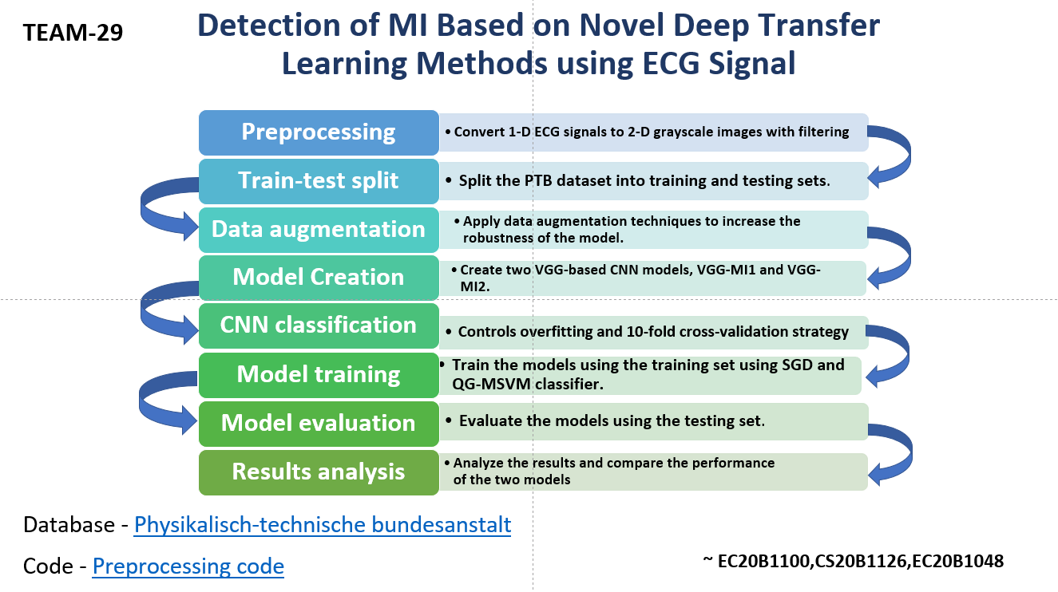

Slide 5
Database Details:
Total 549 records from 290 subjects.
Mean age 57.2.
209 men , mean age 55.5
81 women , mean age 51.6
Each subject represented by one to five records.
16 input channels, 12 leads with 3 Frank lead ECG (vx, vy, vz).

Slide 6
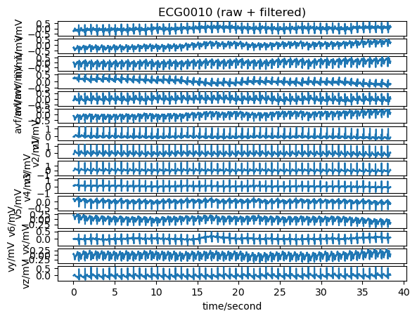
One patient Record with 15 leads

Slide 7
Process we followed:
Training two models (VGG-MI1 and VGG-MI2) using the training set, evaluating their performance using the testing set, and then combining their predictions using an ensemble method.
The ensemble method uses the average probability from both models to make the final prediction. The code also implements a 10-fold cross-validation strategy to control overfitting.
The models are trained using the stochastic gradient descent (SGD) optimizer with a learning rate of 0.001, momentum of 0.9, and nesterov momentum.
The loss function used is binary cross-entropy, and the evaluation metric used is accuracy.
The VGG-MI1 model consists of three convolutional layers followed by max-pooling and two fully connected layers with a dropout of 0.5.
The VGG-MI2 model is based on the VGG16 pre-trained model with the last layer removed, followed by a fully connected layer and a dropout of 0.5.
The code shuffles the training data before training the models, and it uses a batch size of 32 and trains the models for 50 epochs.
The code then evaluates the models using the testing set and calculates the confusion matrices for each model and the ensemble method. The code also uses the QG-MSVM classifier to fit the probability outputs of the ensemble method.

Slide 8
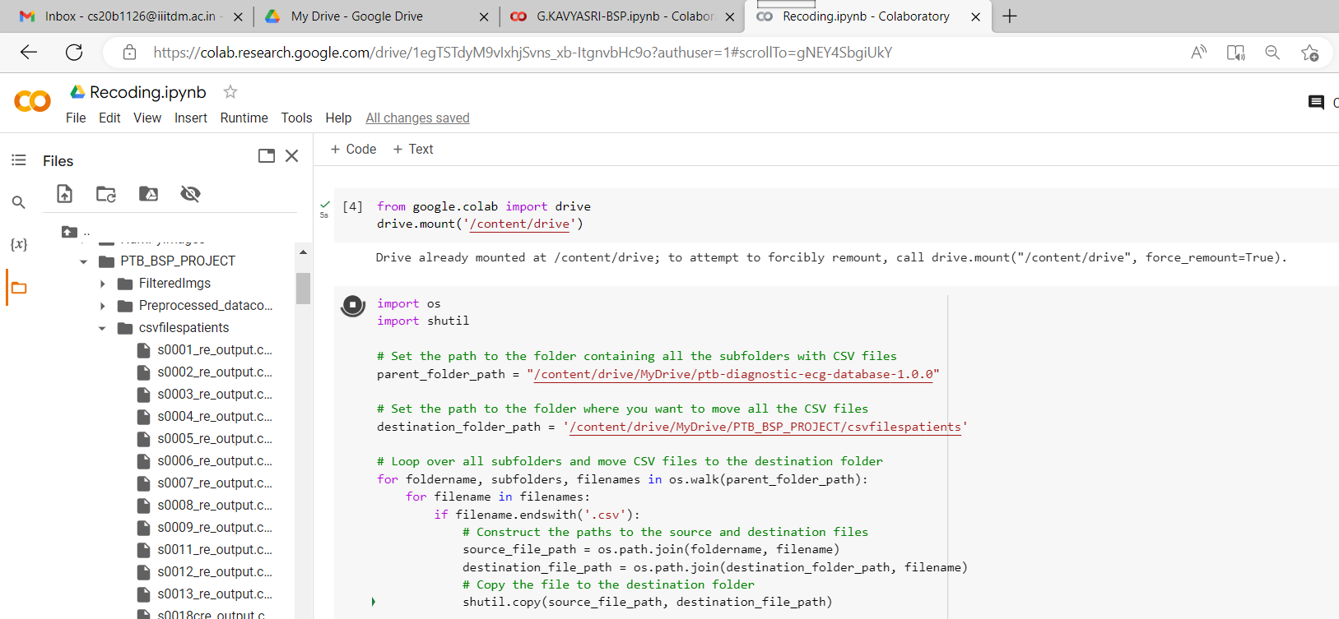
Converted .hea,.dat,.xyz formats to .csv format

Slide 9
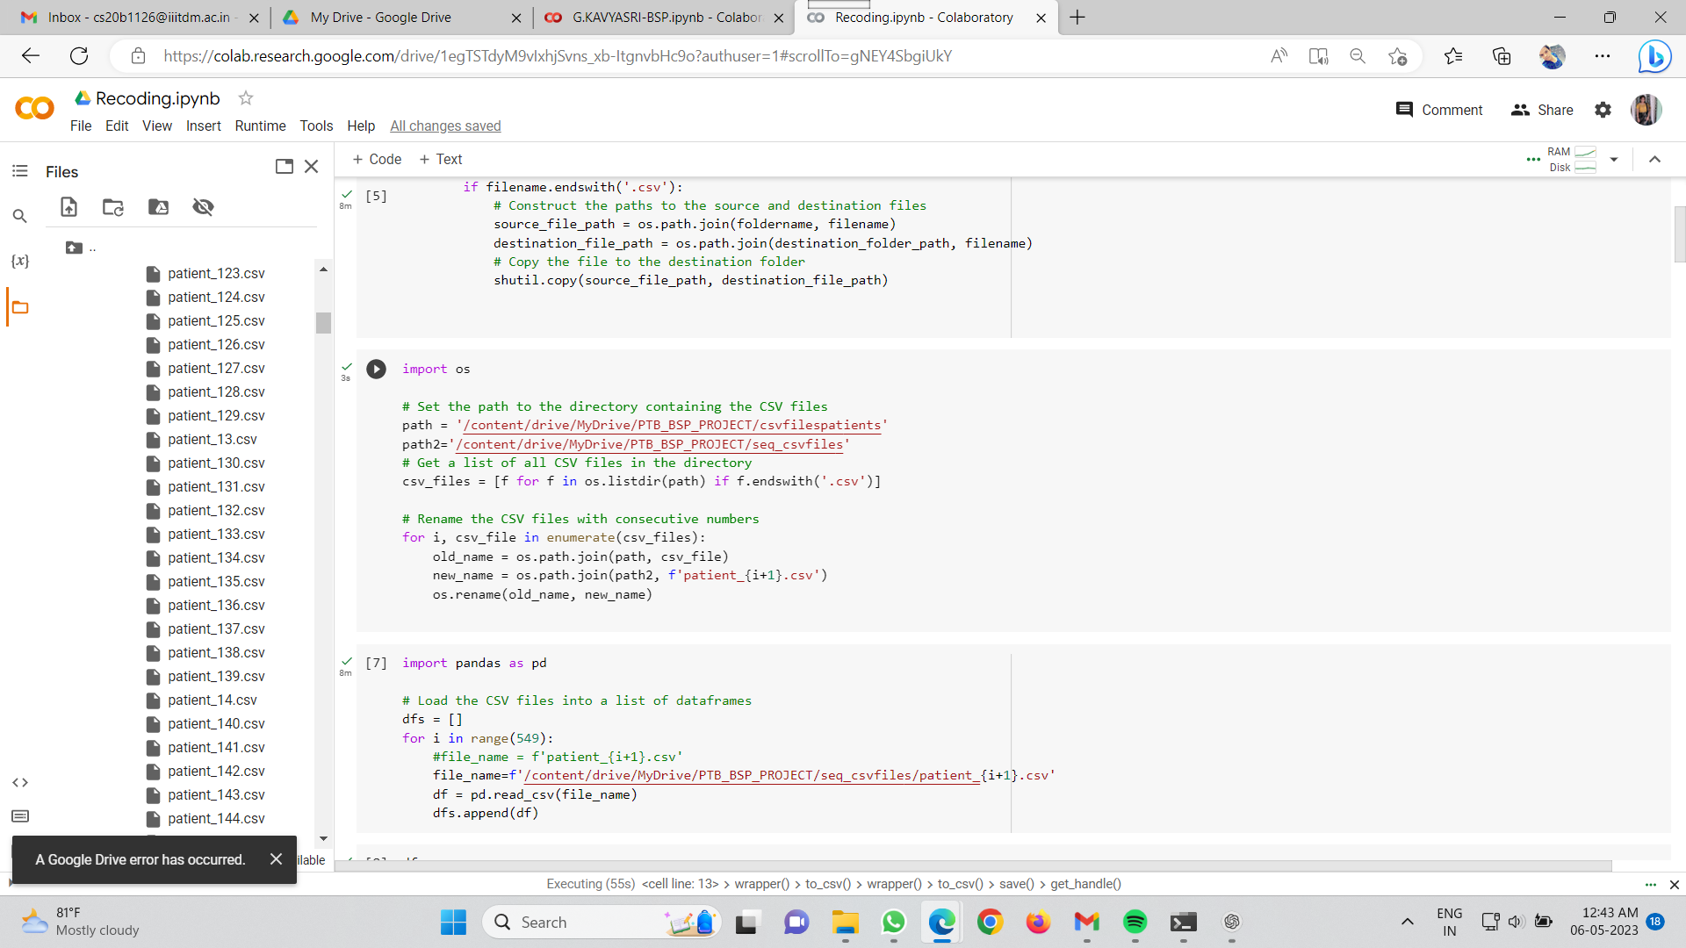
2. Sequential order for all csv files

Slide 10
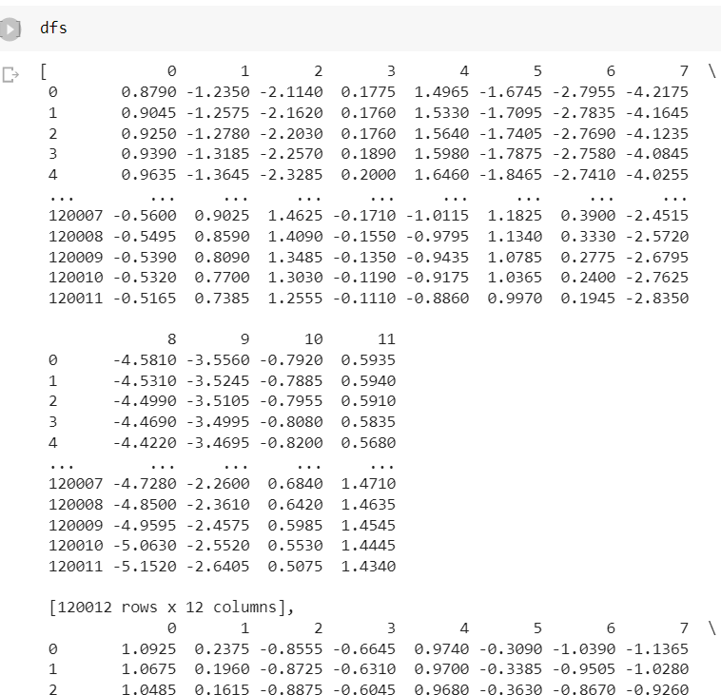
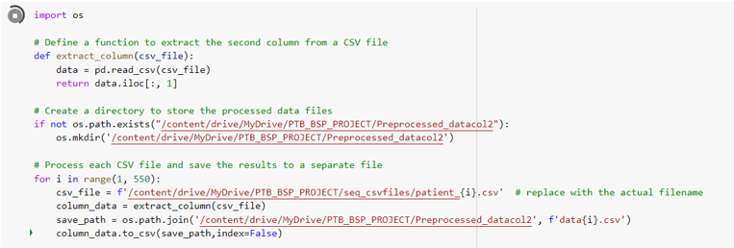
Next collected lead 2 data:
Next Data frames:

Slide 11
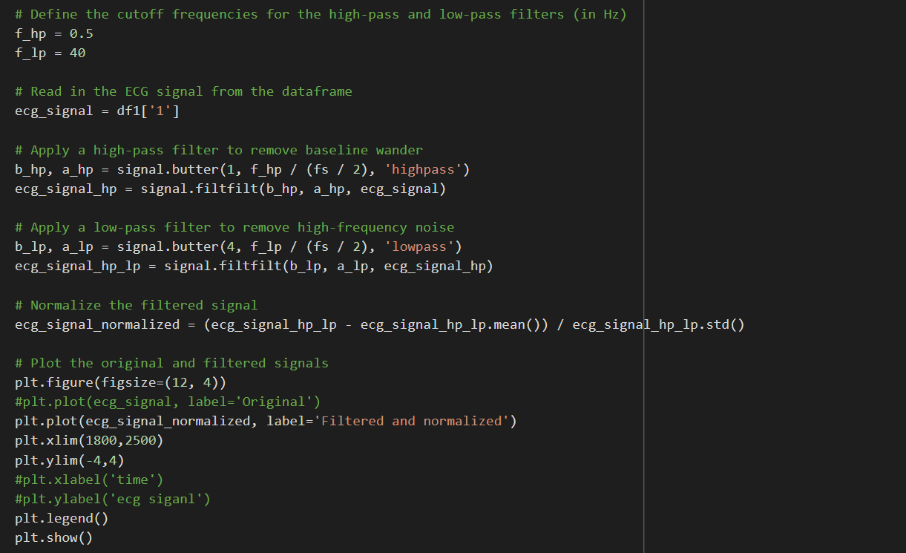
Filtered Signals:

Slide 12
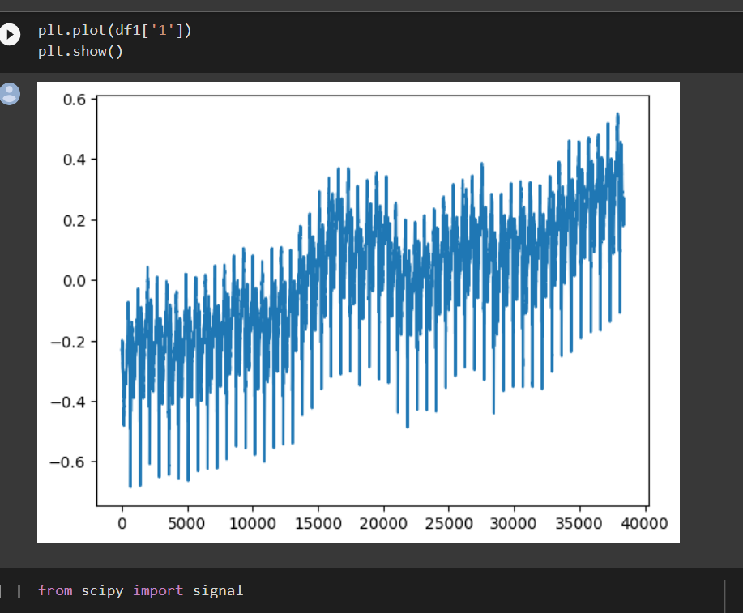
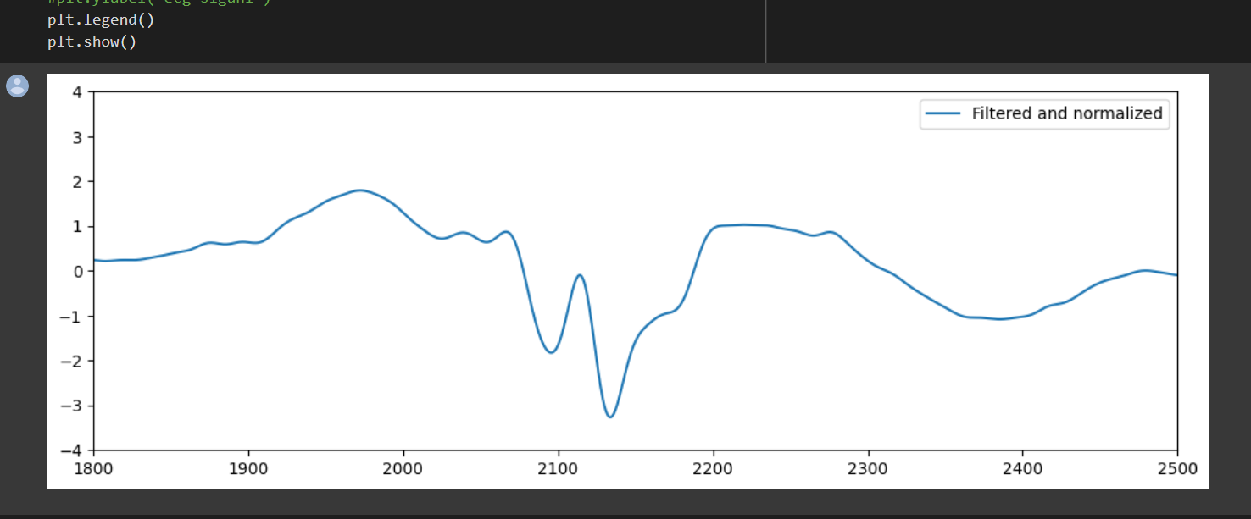
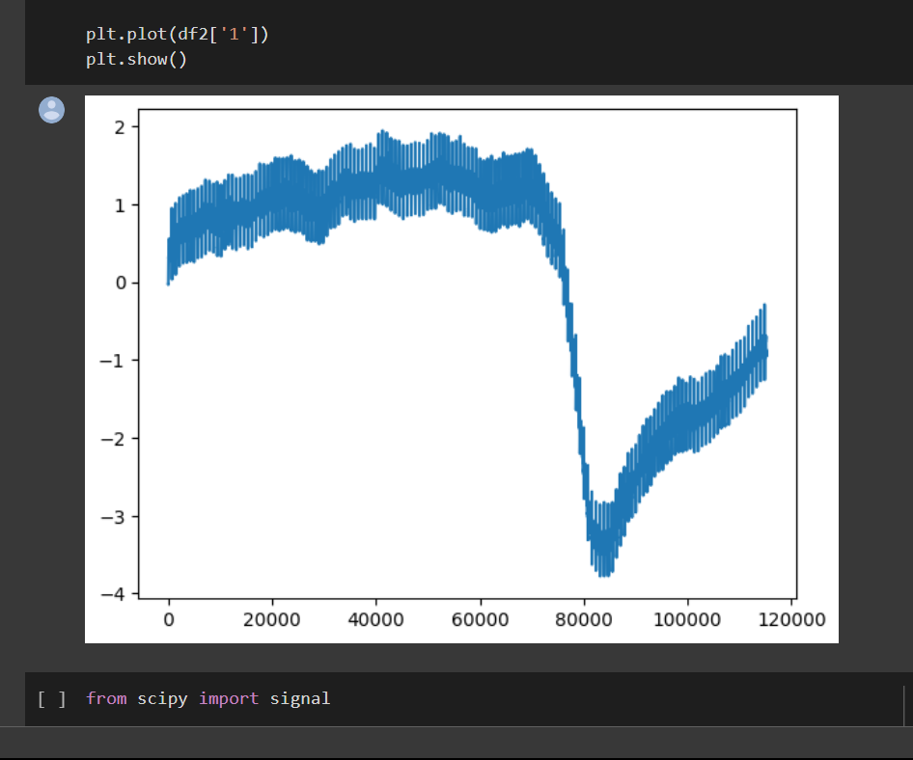
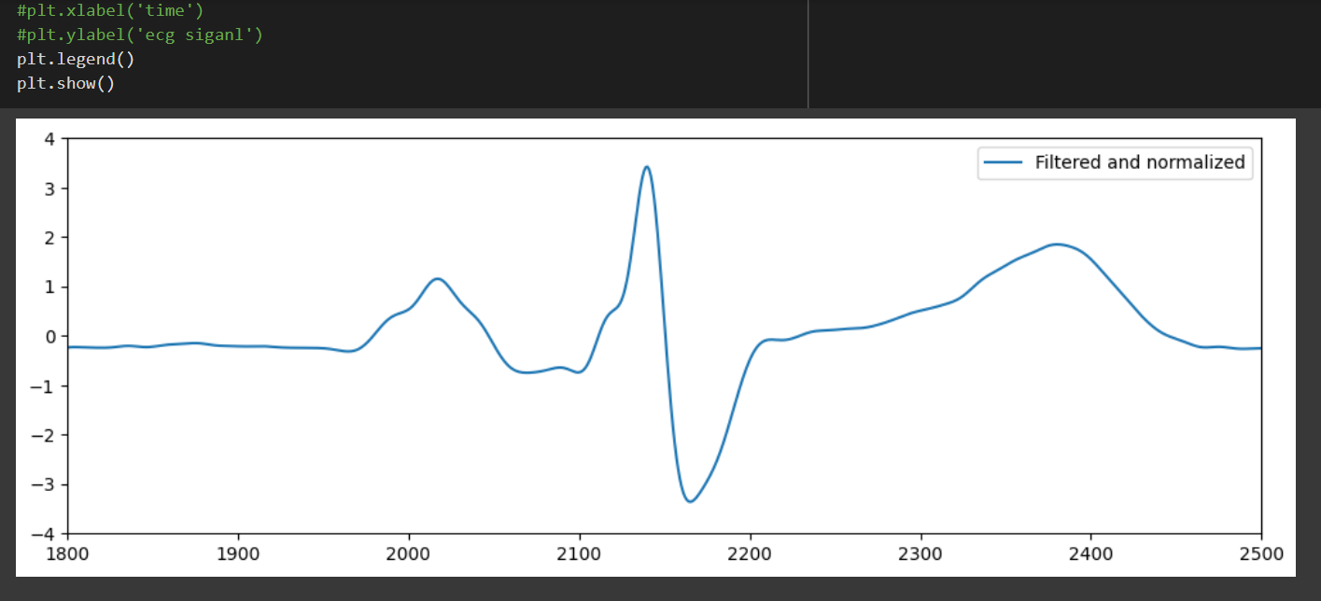

Slide 13
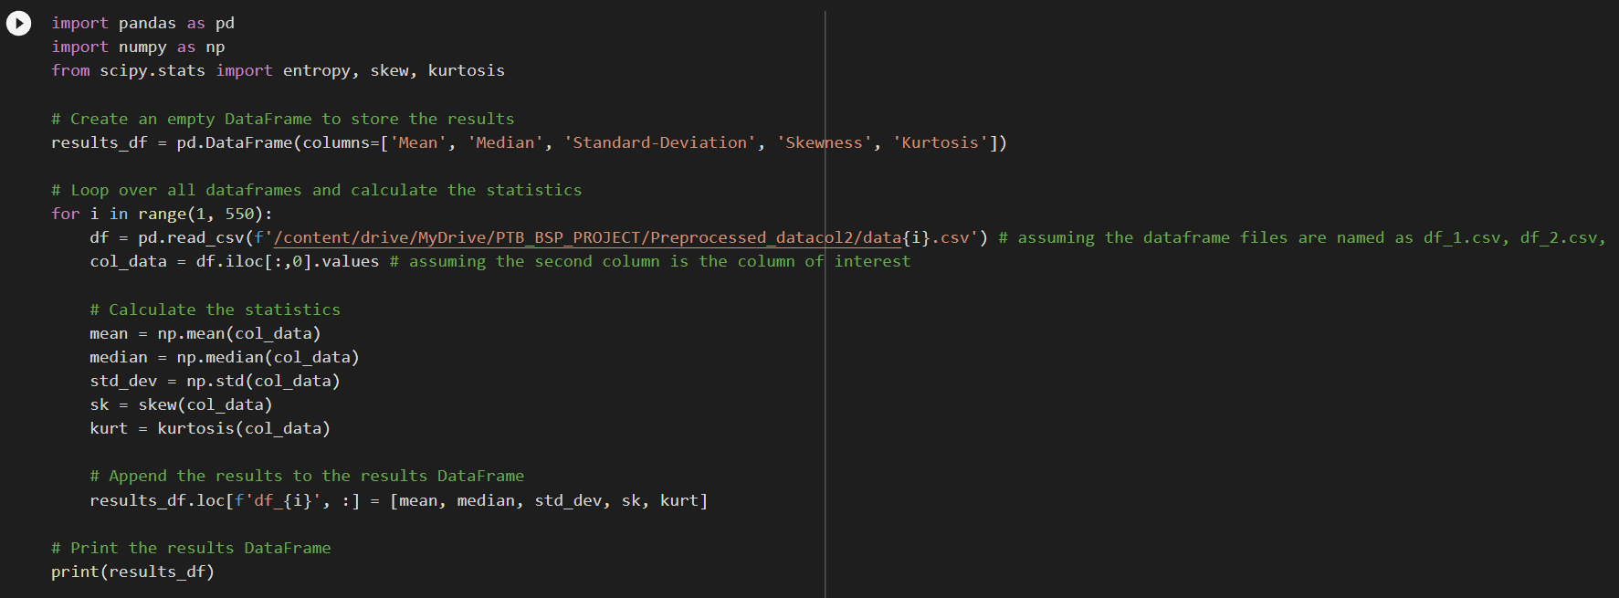
Feature Extraction:

Slide 14
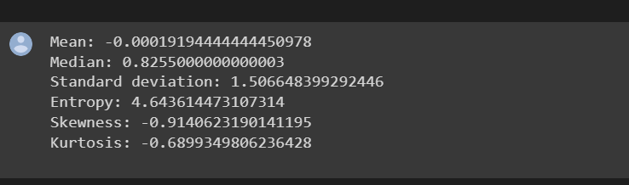
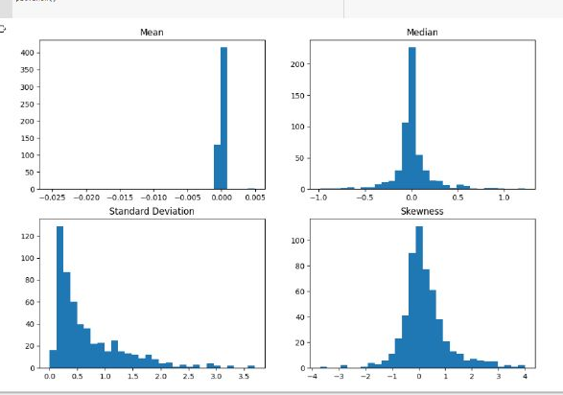

Slide 15
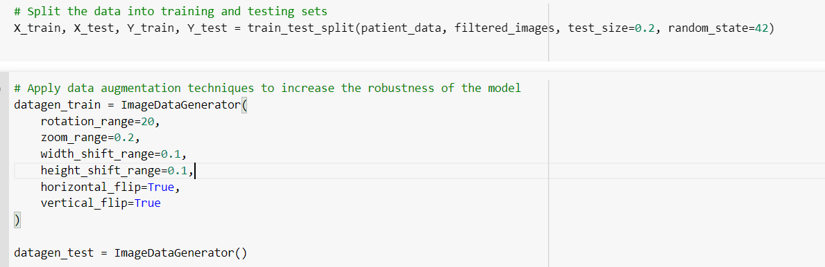
Testing and Training and Data Augmentation

Slide 16
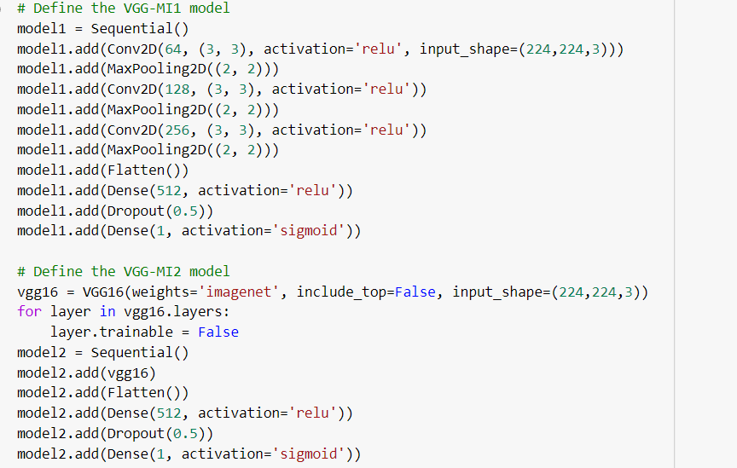
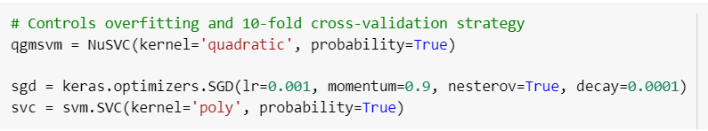
Implementation Of Models
VGG Model
QG-SVM,SVM,SGD Models

Slide 17
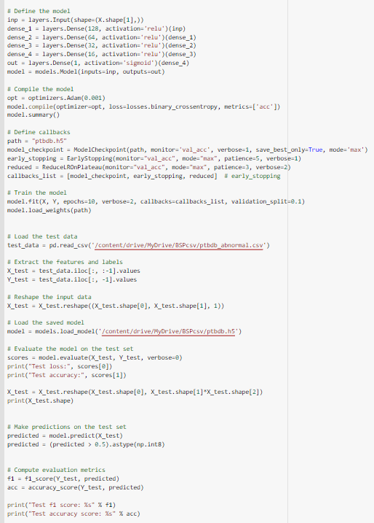

Slide 18
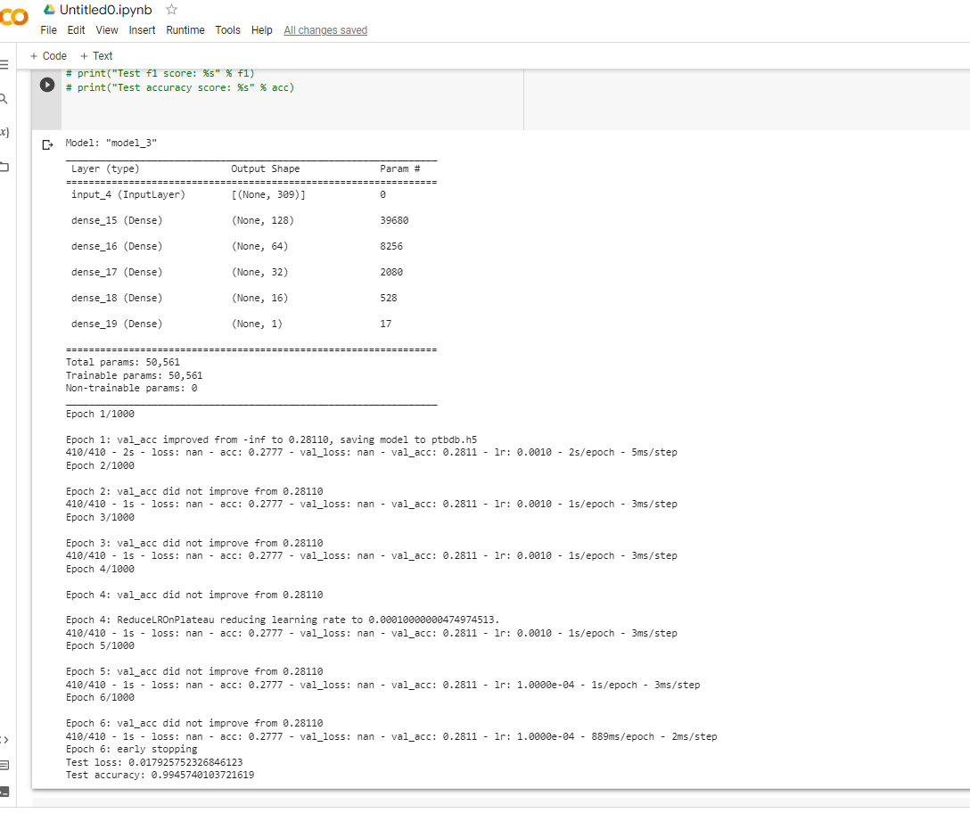
The ECG signal of an MI differs from a normal ECG signal in several ways:
ST-segment elevation
T-wave inversion
Q waves(abnormally deep and wide)
Reduced R wave amplitude:
Abnormal QRS complex

Slide 19
THANK YOU

